Slide 1
PRAGMATIC ANALYSIS OF WHATSAPP CHAT USING NLP
Project Guide : Dr. Sanjay B. Waykar
Group No.: 07
Group Members :-
1) Chavan Pranav Manohar
Roll No. :-04
UID :-120IT1105A
2) Deshmukh Harshraj Sudhakar
Roll No. :- 07
UID :-120IT1234A
3) Dhotre Aakash Damaji
Roll No. :- 11
UID :- 120IT1246A
4) Gharat Aditya Vijaykumar
Roll no :13
UID :- 120IT1084A

Slide 2
CONTENTS
Introduction
Problem Statement
Motivation
Objectives
Requirement Analysis
Feasibility and Scope
Literature Survey
Proposed Work with Methodology
Modeling
Coding / Implementation
Testing
Software and Hardware Platform requirement
Result
Conclusion
Future Scope
References

Slide 3
INTRODUCTION
Contextual Understanding: The project acknowledges the importance of language pragmatics in analyzing WhatsApp chats.
Advanced NLP Integration: By incorporating advanced NLP algorithms, it automates the extraction of nuanced information, surpassing simple keyword matching.
Pragmatic Approach: Unlike traditional methods, it focuses on language pragmatics like implicature and speech acts for a more comprehensive analysis.
Deeper Insights: Through pragmatic principles, the project aims to unveil social roles, conversational strategies, and implicit meanings.
User-Friendly Interface: Prioritizing usability, it offers an intuitive interface for effective interaction with analyzed data, empowering users to make informed decisions.

Slide 4
PROBLEM STATEMENT
Unveiling Hidden Meanings in Informal Communication
Bridging the Gap Between Text and Intent
Decoding User Behavior and Relationships
Building More Effective Communication Tools
Addressing Ethical Considerations

Slide 5
MOTIVATION
Understand user behavior and sentiment in this ubiquitous communication platform.
Gain insights into group dynamics, power structures, and cultural influences.
Develop better marketing strategies, social media analysis tools, and language learning models.
Advance the field of NLP by applying it to a unique and complex data source.

Slide 6
OBJECTIVES
Identify and analyze the sentiment, emotions, and attitudes expressed within the chats.
Uncover key themes and topics discussed, including cultural influences and regional variations.
Analyze conversation flow and structure to understand group dynamics and power structures.
Develop insights into user behavior and communication patterns within WhatsApp groups.
Evaluate the effectiveness of NLP techniques for analyzing informal and dynamic communication data.

Slide 7
REQUIREMENT ANALYSIS
Data Source:
WhatsApp Chat Data (Individual or Group Chats)
Accessible via Export or APIs
Functional Requirements:
Data Collection
Preprocessing
NLP Analysis
Pragmatic Analysis
Visualization and Reporting
Integration

Slide 8
REQUIREMENT ANALYSIS
Non-Functional Requirements:
Performance
Accuracy
Scalability
Usability
Security
Constraints:
Data Privacy
Language Support
Resource Constraints

Slide 9
FEASIBILITY AND SCOPE
Feasibility:
Data Availability
Computational Resources
Technical Expertise
Time Constraints
Scope:
Analysis Depth
Focus Area
Language Coverage
Interpretability

Slide 10
LITERATURE SURVEY
SR. NO | Title Of Paper | Journal/ Conference Name And Year | Author | Key points | Challenges/Remarks
1 | Pre-Processing and Emoji Classification of WhatsApp Chats for Sentiment Analysis | IEEE Conference Publication, 2020 | Astha Mohta, Atishay Jain, S. Dahiya | The paper proposes a method for pre-processing and classifying emojis in WhatsApp chats for sentiment analysis. The method first removes code-switching and other non-textual content from the chats. Then, it classifies the emojis into six categories: happy, sad, angry, fearful, excited, and bored. The classified emojis are then used to improve the accuracy of sentiment analysis. | One challenge with the method is that it requires a large dataset of WhatsApp chats to train the classifier. Another challenge is that the method is not able to handle emojis that are not in the six categories. The authors suggest that future work could focus on addressing these challenges.

Slide 11
LITERATURE SURVEY
SR. NO | Title Of Paper | Journal/ Conference Name And Year | Author | Key points | Challenges/Remarks
2 | Thousands of Small, Constant Rallies: A Large-Scale Analysis of Partisan WhatsApp Groups | 2019 IEEE/ACM International Conference on Advances in Social Networks Analysis and Mining | Victor S. Bursztyn, Larry Birnbaum | The paper presents a large-scale analysis of partisan WhatsApp groups in India. The analysis found that these groups are highly active, with members sending an average of 20 messages per day. The groups are also highly polarized, with members overwhelmingly sharing content that aligns with their political views. The findings suggest that WhatsApp groups are playing an important role in political mobilization in India. | One challenge in conducting this study was the difficulty in obtaining access to WhatsApp groups. Another challenge was the large volume of data that was collected. The authors suggest that future work could focus on understanding the impact of WhatsApp groups on political behavior.

Slide 12
LITERATURE SURVEY
SR. NO | Title Of Paper | Journal/ Conference Name And Year | Author | Key points | Challenges/Remarks
3 | People's Behavior Analysis in Chat Message using Natural Language Processing | Proceedings of the Third International Conference on Intelligent Communication Technologies and Virtual Mobile Networks (ICICV 2021). | V.Selina Annie Retna, Prof. P. Brundha, Dr. RajKumar G | The paper proposes a method for analyzing people's behavior in chat messages using natural language processing (NLP). The method first extracts features from the chat messages, such as the words used, the sentiment of the messages, and the time of day the messages were sent. Then, it uses NLP to train a classifier to identify different types of behavior, such as friendly, aggressive, or neutral. The method is evaluated on a dataset of chat messages, and it is shown to be effective in identifying different types of behavior. | One challenge in conducting this study was the difficulty in obtaining a large dataset of chat messages. Another challenge was the complexity of the NLP task. The authors suggest that future work could focus on improving the accuracy of the classifier and on developing new applications for the method.

Slide 13
LITERATURE SURVEY
SR. NO | Title Of Paper | Journal/ Conference Name And Year | Author | Key points | Challenges/Remarks
4 | Text Classification based Behavioural Analysis of WhatsApp Chats | Proceedings of the Fifth International Conference on Communication and Electronics Systems (ICCES 2020) | Sonika Dahiya, Astha Mohta, Atishay Jain | The paper proposes a text classification based behavioral analysis model for identifying introverts and extroverts using WhatsApp chats. The model uses a neural network to score each sentence and emoji in a dimensional form, based on the emotions expressed by the subject. The model is able to determine if the subject is an introvert or extrovert with an accuracy of 80%. | The main challenge in this study was the code switching that is prevalent in online conversations. The model was trained on a dataset of 1000 WhatsApp chats, which may not be representative of the entire population. Future work could involve using a larger dataset and incorporating other factors, such as the time of day and the frequency of messages, to improve the accuracy of the model.

Slide 14
LITERATURE SURVEY
SR. NO | Title Of Paper | Journal/ Conference Name And Year | Author | Key points | Challenges/Remarks
5 | Towards a New Approach to Identify WhatsApp Messages | 2020 IEEE 19th International Conference on Trust, Security and Privacy in Computing and Communications (TrustCom) | Rick Cents and Nhien-An Le-Khac | The paper proposes a new approach to identify WhatsApp messages using only wiretap data. The approach is based on identifying patterns of data sent to and received from the WhatsApp servers. The approach was tested against a large dataset created with different mobile devices, and the results showed that it is effective in identifying WhatsApp messages. | The main challenge of the approach is that it requires a large dataset of WhatsApp traffic to train the pattern recognition model. The approach is not foolproof, and there are some cases where it may not be able to identify WhatsApp messages correctly. The approach is still under development, and the authors are working on improving its accuracy and reliability.

Slide 15
PROPOSED WORK WITH METHODOLOGY
Data Collection and Preprocessing
2. Sentiment Analysis
3. Named Entity Recognition (NER)
4. Topic Modeling
5. Pragmatic Analysis
6. Visualization and Reporting
7. Iterative Refinement
8. Integration and Deployment

Slide 16
MODELING
Software Development Process Model: The Incremental Model suits the chat analyzer project's iterative enhancement of text analysis capabilities, graphical representations, and user interface improvements over time, aligning well with its evolving nature through gradual addition of features.
Data Objects Identification: Data objects include messages, chat participants, timestamps, and analysis results, with attributes like message content, sender, and time sent, while relationships entail associations between messages and participants, timestamps, or analysis outcomes.
Matching Objects with Classes: Classes for message parsing extract information from chat logs, statistical analysis computes metrics such as message frequency or sentiment, and visualization classes render graphs or charts based on analysis results.
Requirement Analysis and Modeling: Use case diagrams illustrate functionalities like importing chat logs, performing analysis, and generating reports, while activity diagrams detail the workflow of analyzing a chat log, from parsing messages to displaying results.

Slide 17
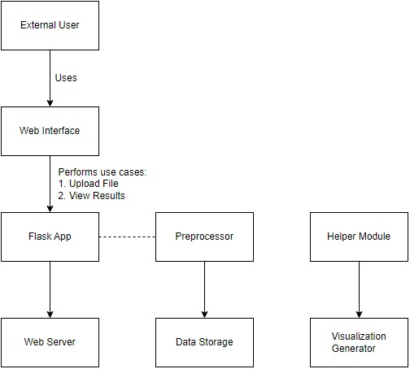
MODELING
Requirement Analysis and Modeling
Fig.1: Use Case Model

Slide 18
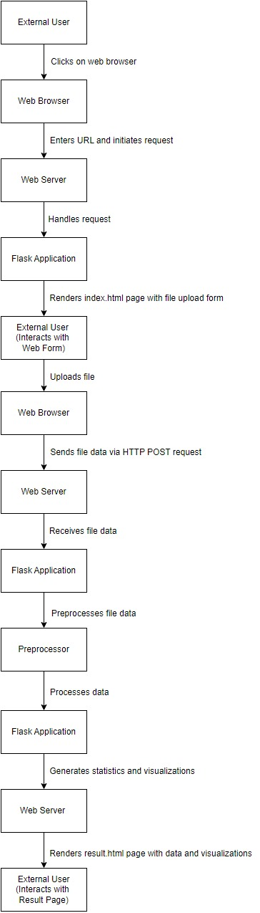
MODELING
Fig.2: Activity Diagram

Slide 19
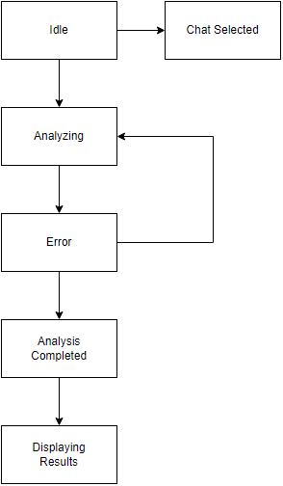
MODELING
System State Transition Diagram: The system transitions from the "Idle" state to "Parsing Chat Log" upon user request to import a chat log file, then to "Analyzing Data" once parsing is complete; the state transition diagram visually represents these changes and the triggering events, aiding in understanding the system's behavior and flow.
Fig.3: System State Transition Diagram

Slide 20
MODELING
Interface and Functional Dependencies: The repository clearly outlines modules for data preprocessing, text analysis, and visualization, with functional dependencies described through comments and documentation, ensuring modularity, maintainability, and facilitating debugging, testing, and future enhancements.
Architectural Model: The project adopts a layered architectural model, with separate layers for data preprocessing, analysis, and visualization, enabling modular development and independent updates within each layer for scalability and maintainability.

Slide 21
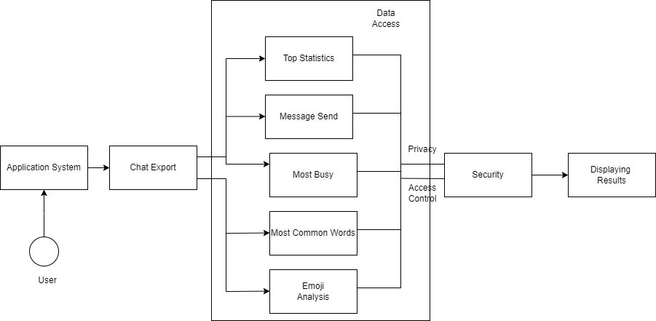
MODELING
Architectural Model
Fig.4: Architecture Diagram

Slide 22
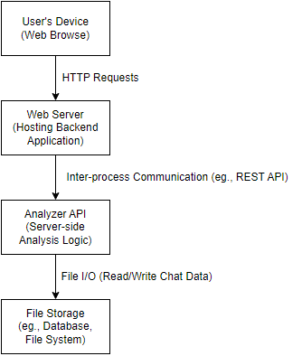
MODELING
Deployment Diagram: Each layer of the architecture corresponds to different components or services deployed in the system, such as preprocessing, analysis and visualization modules, distributed across servers or platforms based on scalability requirements and resource constraints.
Fig.5: Deployment Diagram

Slide 23
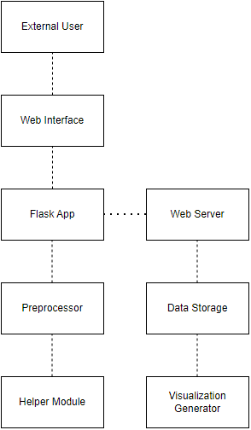
MODELING
Component Diagram
Fig.6: Component Diagram

Slide 24
CODING / IMPLEMENTATION
Code Implementation vs. Design: The project effectively parses and analyzes WhatsApp chat data, accurately extracting message content, timestamps, and participant information, and generating insightful visualizations such as message frequency graphs and word clouds, with interactive features like message filtering and keyword search.
Coding Standards Compliance: The Python scripts adhere to PEP 8 formatting conventions, with well-structured functions and classes, descriptive variable names in snake_case notation, effective use of comments, and modularization into parsing, analysis, and visualization modules, promoting code reusability and maintainability, albeit with minor room for improvement in coding standards adherence.
Code Structure and Consistency: The project showcases well-organized code with clear module separation, descriptive naming, consistent indentation, effective use of comments and docstrings, adherence to best practices, and automated tests for code correctness.

Slide 25
CODING / IMPLEMENTATION
Implementation of Design Functions: The project outlines functions such as parse_message, analyze_sentiment, and generate_report.
Object-Oriented Concepts Usage: The project employs object-oriented principles via classes like Message, encapsulating message data and analysis methods, facilitating modular and reusable handling of message data and analysis tasks.
Granularity Support: The project provides customizable analysis options like sentiment analysis, keyword extraction, and message statistics, enhancing flexibility and usability.
Language Choice and Project Needs: Python's robust libraries like Pandas and Matplotlib suit the project's needs for data analysis and visualization, while its simplicity, readability, and extensive community support make it a suitable choice for parsing and analyzing chat data.
Off-the-Shelf Components Understanding: The project leverages Pandas and Matplotlib for data analysis and visualization, requiring understanding of Pandas for data manipulation and Matplotlib for creating insightful visualizations.

Slide 26
CODING / IMPLEMENTATION
Comments Consistency: The project demonstrates consistency between comments and code in some sections, with detailed comments explaining specific functions or methods, ensuring clarity and alignment, yet sparse comments in other areas, like the visualization module, could lead to discrepancies between code and explanations, suggesting room for improvement in maintaining consistency for overall clarity.
Code Optimization: The project transitioned from nested loops to optimized data structures or built-in functions like NumPy or Pandas for improved performance in data manipulation tasks.

Slide 27
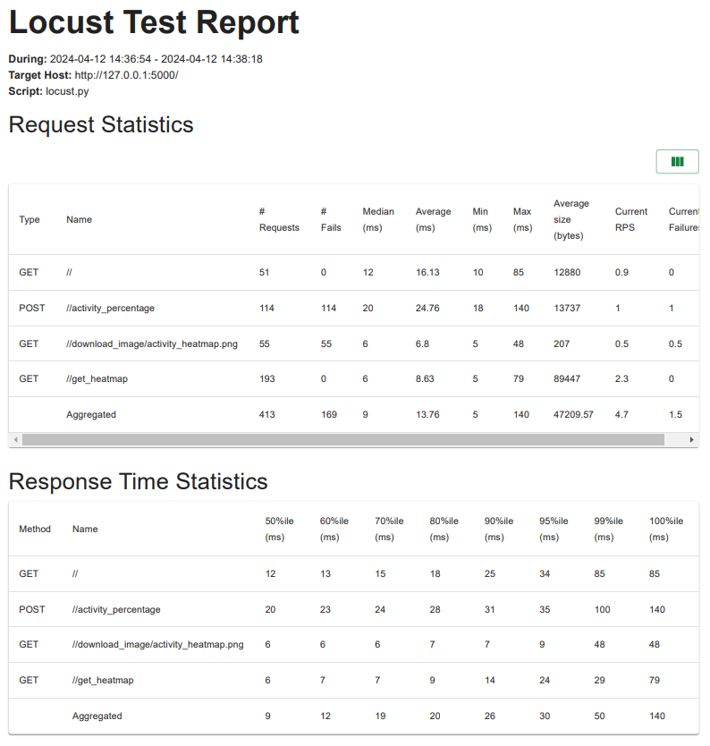
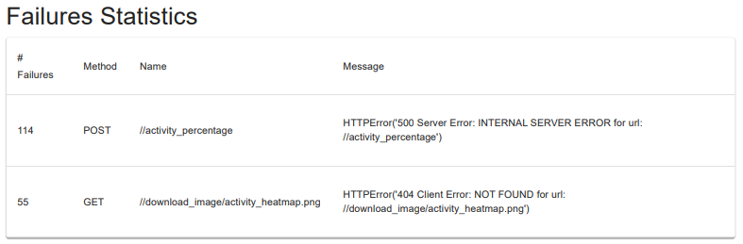
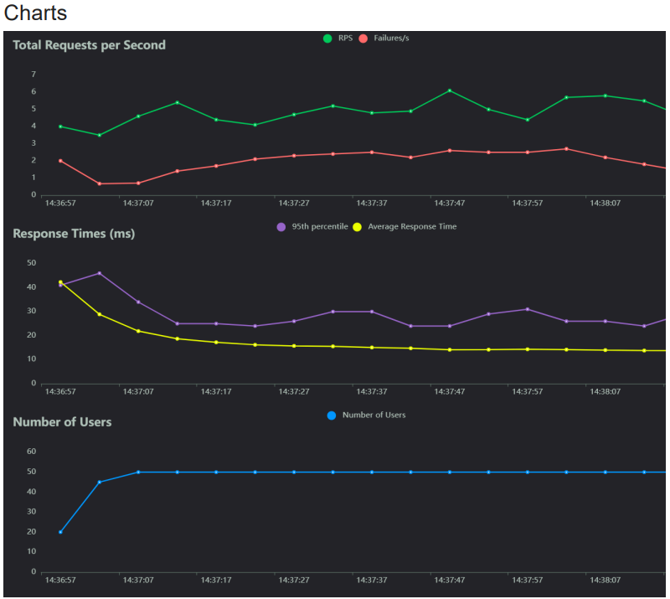
TESTING
Performance Test

Slide 28
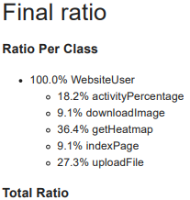
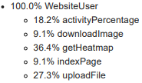
TESTING
Performance Test

Slide 29
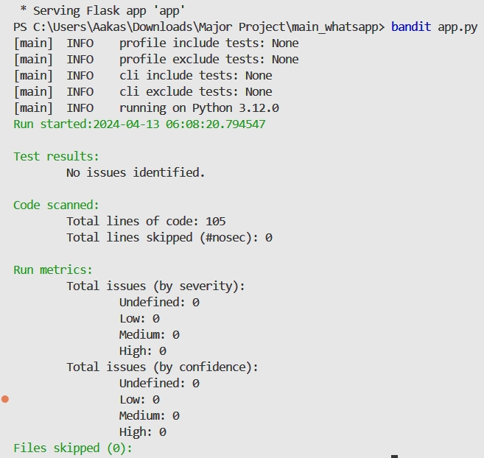
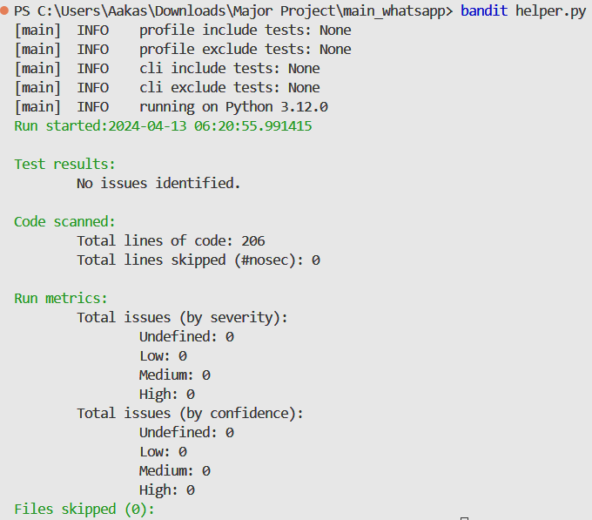
TESTING
Security Test

Slide 30
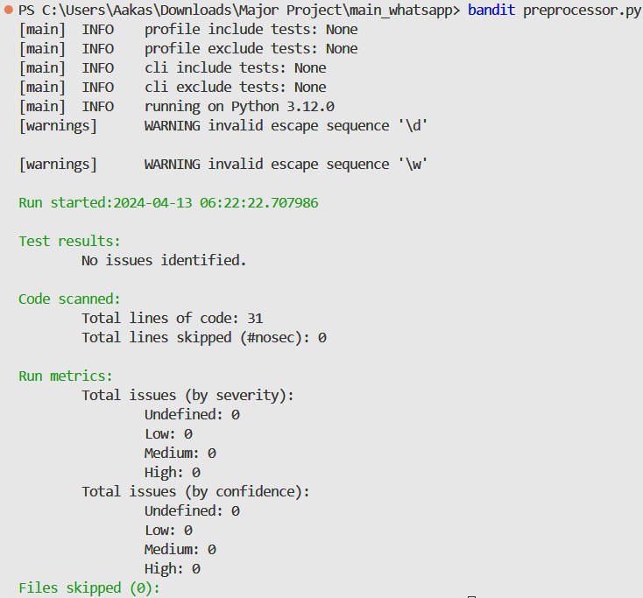
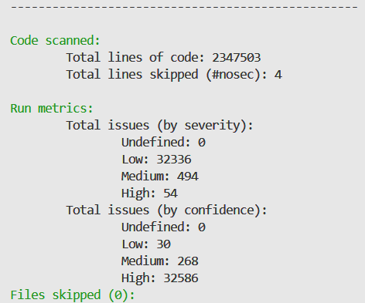
TESTING
Security Test

Slide 31
SOFTWARE AND HARDWARE PLATFORM REQUIREMENT
Software
Operating System
VS Code
Python
Python Libraries
Hardware
Processor: Intel core i3
Memory: 4GB RAM
Storage: 5GB
Network Connectivity.

Slide 32
RESULT
After analyzing the WhatsApp chat data, the project typically presents the results in a user-friendly format for easy interpretation. This could include:
Visualizations: Charts, graphs, or word clouds illustrating message frequency, sentiment analysis, or other metrics.
Summary Statistics: Key metrics such as total messages sent, average message length, most active participants, etc.
Textual Reports: Detailed analysis reports summarizing findings and insights from the chat data.
Overall, the result and analysis of the "Pragmatic Analysis of WhatsApp Chat Using NLP" project aim to provide users with valuable insights into their chat data, facilitating self-reflection, relationship management and communication improvement.

Slide 33
CONCLUSION
Analyzing WhatsApp chat data can provide valuable insights into communication patterns, popular words, emojis usage, and activity trends.
By leveraging Python libraries for data processing and visualization, we can extract meaningful information from raw chat data and present it in an interactive web interface.
This code snippet forms the foundation for building a WhatsApp chat data analysis tool that can help users gain a deeper understanding of their messaging habits.
The provided Python function efficiently preprocesses chat data by decoding, extracting, and structuring messages and dates into a DataFrame. By utilizing regular expressions and data.

Slide 34
FUTURE SCOPE
Advanced NLP Techniques: Implement advanced NLP models like BERT for more accurate sentiment analysis and entity recognition.
Multimodal Analysis: Integrate image and voice data from WhatsApp to enable multimodal analysis, expanding insights beyond text.
Real-time Analysis: Develop real-time analysis capabilities to provide instant feedback and insights during ongoing conversations.
Cross-platform Integration: Extend analysis to other messaging platforms like Telegram, WeChat, or Facebook Messenger for broader insights.
Personalization: Utilize machine learning algorithms to personalize communication strategies based on individual user preferences and behavior patterns.

Slide 35
REFERENCES
Pre-Processing and Emoji Classification of WhatsApp Chats for Sentiment Analysis: https://ieeexplore.ieee.org/document/9243443
Thousands of Small, Constant Rallies: A Large-Scale Analysis of Partisan WhatsApp Groups: https://ieeexplore.ieee.org/document/9073450
People's Behavior Analysis in Chat Message using Natural Language Processing: https://ieeexplore.ieee.org/document/9388596
Text Classification based Behavioural Analysis of WhatsApp Chats: https://ieeexplore.ieee.org/document/9137911
Towards a New Approach to Identify WhatsApp Messages: https://ieeexplore.ieee.org/document/9343229

Slide 36
THANK YOU

